Slide 1
Welcome Families!
Phillips Band
Interest Meeting

Slide 2
Who is the Band Director?
Mr. Sample has been teaching band at Phillips Middle School since 2016. This is his 19th year teaching band overall. Mr. Sample holds a Bachelor's Degree in Music Education from Tennessee Technological University, a Master’s Degree in Music Education from UNCG and a Master’s Degree in Music Performance from UNCG. Mr. Sample has competed and performed internationally on the Euphonium and has been involved in several Grammy-nominated recordings. More recently, Mr. Sample has performed solos with the ECHHS Band and played Tuba as a member of the Village Community Band.
Mr. Ashley Sample
Notes:
Take a few moments to briefly introduce yourselves to you new music families. While stating your qualifications may be important, parents are more interested in what kind of teacher you will be and whether their child will connect with you as a person.

Slide 3
Our Band program
Everyone is Welcome!
Community / Friendships
Life Skills / Unique Way of Thinking
Music is a core human experience
Notes:
Highlight aspects of your program here. Accolades are fine, but you may want to talk about the culture of your program and what it does for students.
Add your own photos to this slide deck to make this more personal and to better represent the demographics of your school population

Slide 4
We are committed to helping your child be the best that he / she / they can be!
Notes:
This is a good time to talk about how you support your students.

Slide 5
Do I need prior experience?
NO! Everyone is welcome to join our Band program. Most students in the class will be learning their instrument for the very first time with little to no music experience! We all bring our strengths into the classroom and have a valuable voice that needs to be heard!

Slide 6
What if I have experience playing an instrument?
If you have been studying your instrument privately before coming to middle school, we also want you in our Band program. There are many things we learn in band that are not taught in private lessons (ensemble, leadership, and theory skills). Also, there will be opportunities for Honors Band auditions that require you to be in the school band to participate in!

Slide 7
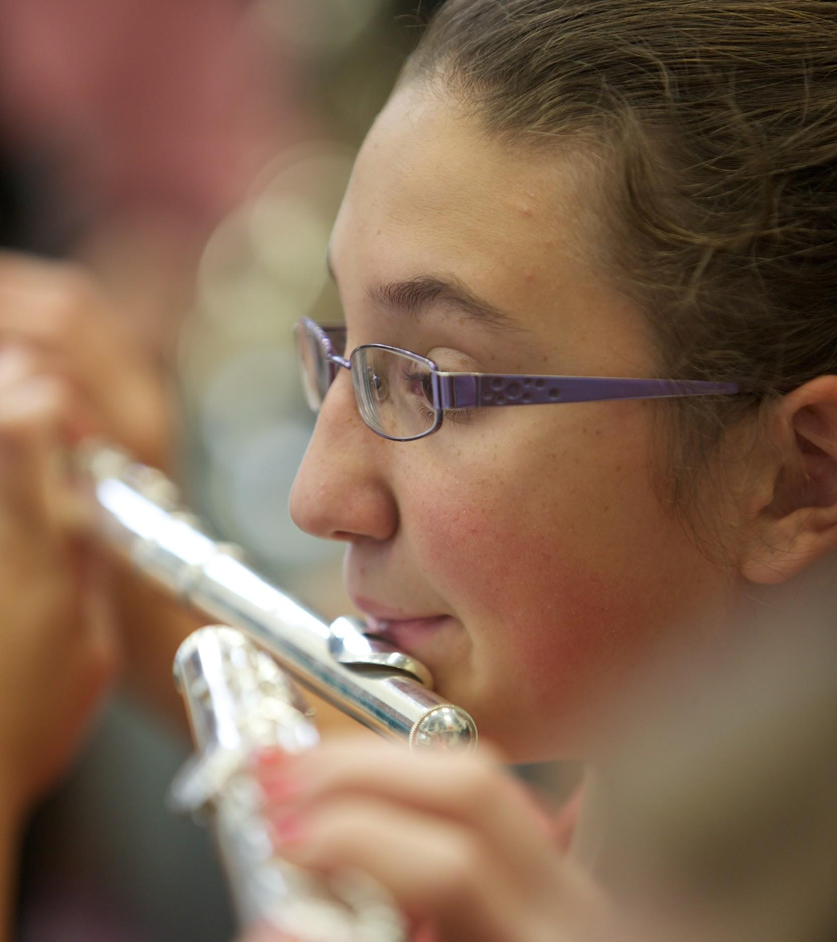
Which Instruments can we play in Band?
We start with flute, clarinet, trumpet or trombone. After a semester, students have the opportunity to audition for auxiliary instruments such as oboe, bassoon, saxophone, euphonium, tuba and percussion. Only a handful of students will be chosen for auxiliary instruments as we need lots of flute, clarinet, trumpet and trombone players!
Notes:
It’s important for everyone to understand what type of commitment they are making up front so they are not surprised down the road.

Slide 8
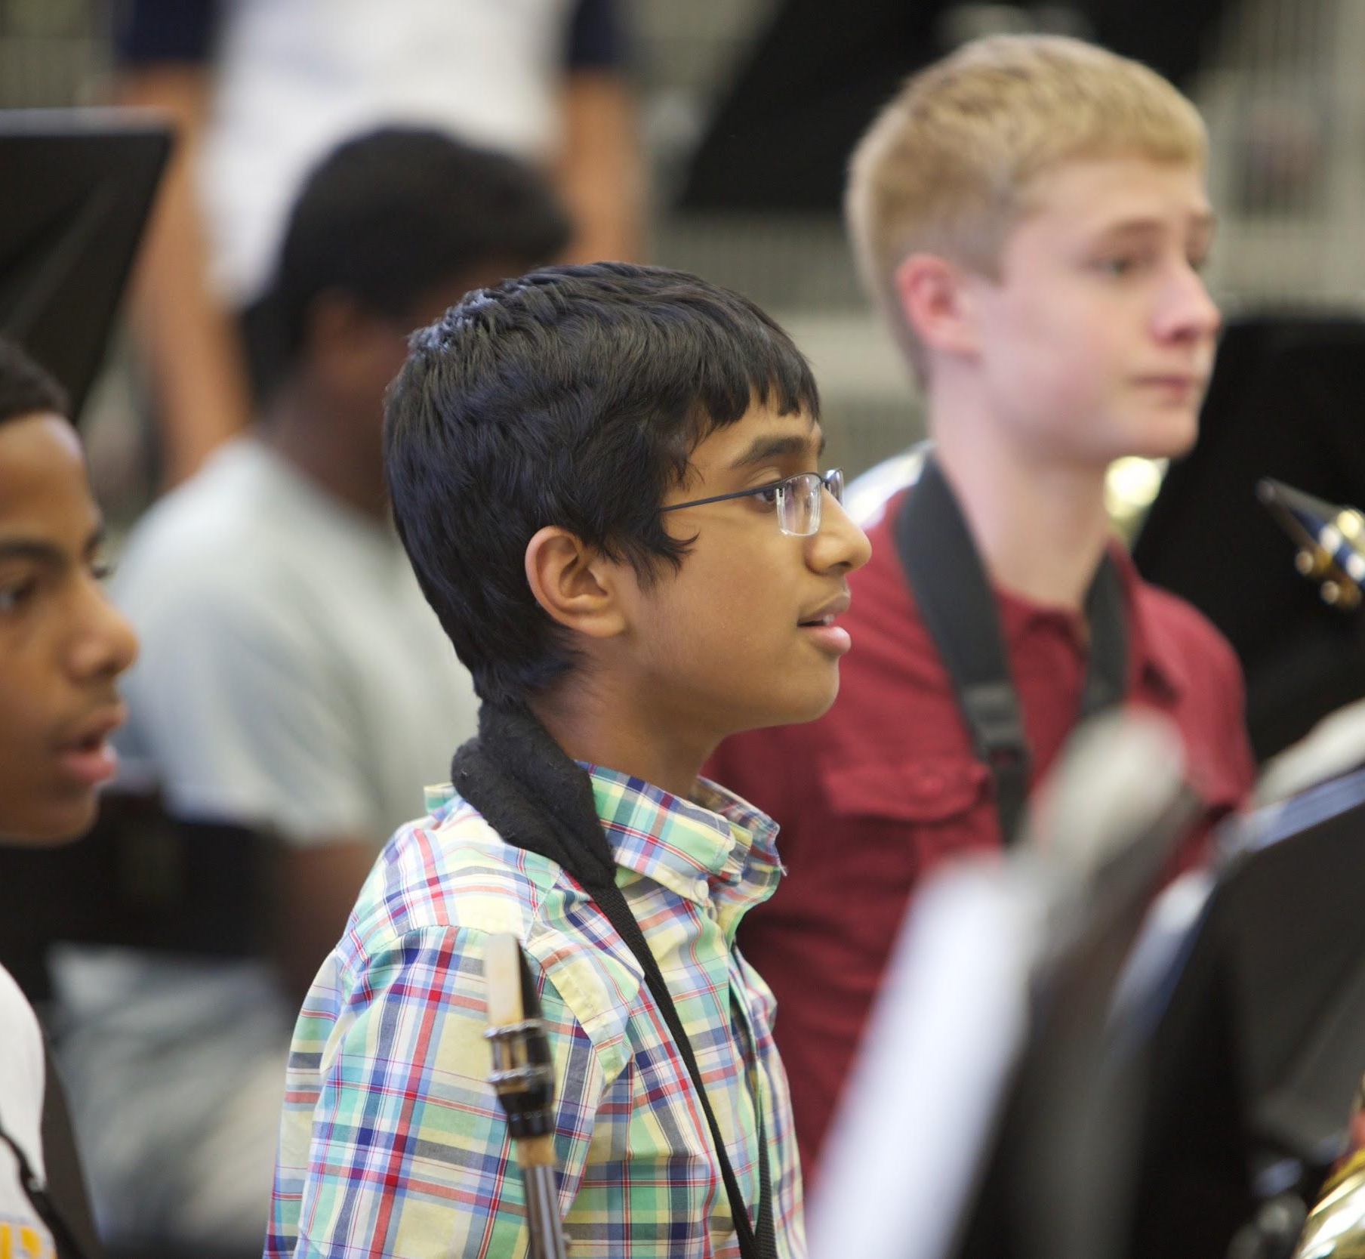
What do we ask of students?
Do your best
Ask for help if you need it
Practice your instrument at home regularly
Make at least a one-year commitment
Notes:
Talk about your expectations of students. Now is the time to help kids and parents see that the commitment to learning an instruments is reasonable rather than overwhelming.

Slide 9
How can parents help?
Expect progress to be slow at first
Be encouraging
Help your child stick to a practice schedule
Listen to your child play
Consider private lessons
Notes:
Many of your new music parents may not have any experience playing an instrument. Assure them that they still will be able to give their child the support he or she needs to be successful.

Slide 10
Practice for Success
About 20 minutes per day is best
Setting a schedule helps
Work toward goals
Your child will need your support in maintaining a regular practice routine
Notes:
It’s important for everyone to understand what type of commitment they are making up front so they are not surprised down the road.

Slide 11
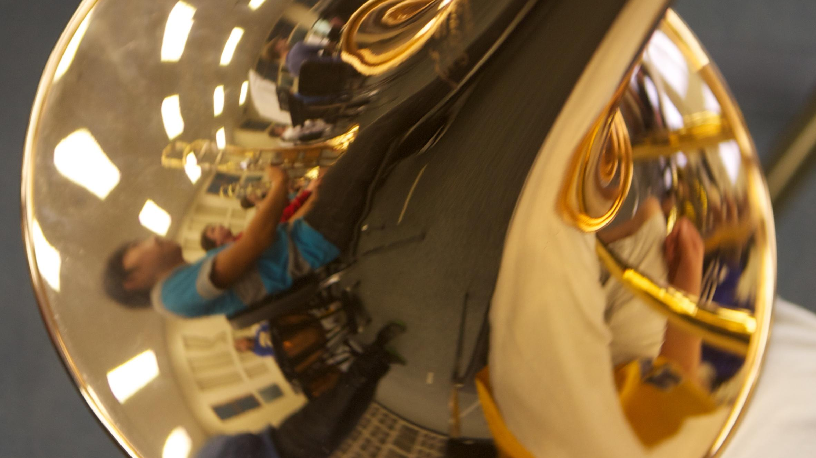
Purchase or Rent?
Renting is recommended at first.
Then when you purchase, stick with trusted brands and trusted stores. We can help!
Notes:
You may also want to discuss school owned instruments at this time.

Slide 12
What if renting isn’t an option right now?
If you are not able to afford a rental option, no problem! We have some great school instruments that we would love for you to use. It is a huge priority here at Phillips that anyone who wants to join band is welcomed and has a quality instrument to play!
Notes:
You may also want to discuss school owned instruments at this time.

Slide 13
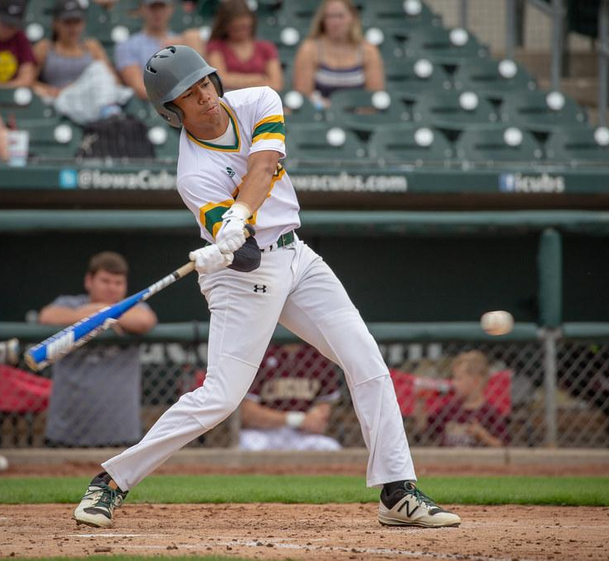
Can I play sports and be in band?
Yes, you can play sports and be in band! Many of our students in Band are also on sports teams. Band is a class during the school day. However, we do have concerts throughout the year as well as some co-curricular opportunities.
Notes:
Talk about your expectations of students. Now is the time to help kids and parents see that the commitment to learning an instruments is reasonable rather than overwhelming.

Slide 14
What do we do beside play our instruments in class?
3 to 4 concert performances each year [ family & friends ]
Music Performance Adjudication Festival [MPA]
Jazz Band
Small Ensembles
Performances around our community
Honors Band Auditions & Clinics [County, District & State]
Mentorship Program [HS/MS collaboration]
Performance-based Field Trips in and out of state [Carowinds]
I would like to start a percussion ensemble
I would like to start a Pep Band to play at Basketball games

Slide 15
Attention!
Taking an art credit is now a required part of high school graduation.

Slide 16
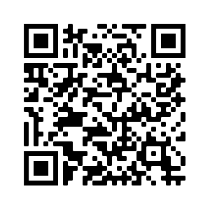
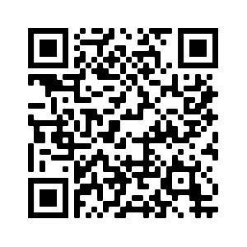
Interest Form:
Matching Tool:
When you have a moment,
please fill out the following:

Slide 17
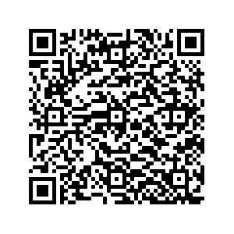
Online Rental Form

Slide 18
Questions?

